Slide 1
{company_name} - Asset Pack
KGS
{month_year}

Slide 2
Table of contents
01 | Deal Overview | 3
02 | Company Profile | 5
 | Company Overview | 6
 | Key personnel | 7
 | Geographic presence | 8
 | Business segments | 9
03 | Market Overview | 11

Slide 3
Deal Overview
01

Slide 4
Deal Overview
{company_name} | Asset pack
{deal_overview}
Situation overview
Timing
Deal rationale
Business summary
Why KPMG
KPMG view
{sit_overview}
For further details, please refer to Appendix A
{deal_stage}
{deal_rationale}
{biz_desc}
{next_step}
Source: Merger market; accessed on {date}

Slide 5
Company Overview
02

Slide 6





Overview
{company_name} | Asset pack
{biz_summary}
Key facts
Business overview
Founded
Headquarters
{biz_desc}
{found_year}
{dominant_country}
Employees
Company Type
{employee_num}
Privately Held
Impact of {company_name}
Group Structure
{company_name}
CO2
Social
Venture
{water_L} liters of water saved annually
{lives} lives saved annually
{tree_num} tress needed to absorb the same amount of CO2 annually
{co2} tons of carbon emission prevented annually
Source: <Please fill in sources and links, Format: sources, link;>; accessed on {date}

Slide 7
Geographic presence
{company_name} | Asset pack
{company_name} has presence across {num_countries} countries around the globe, with majority of foothold being in {dominant_country} continent
Source: {company_name}, website {link}; accessed on {date}

Slide 8












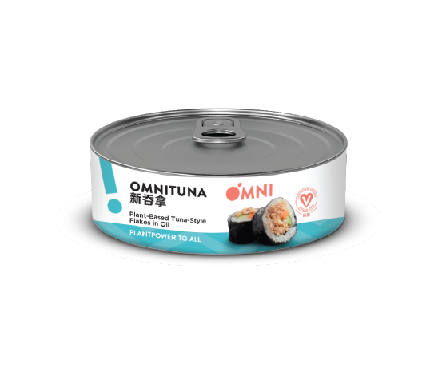





Business segments (1/2)
{company_name} | Asset pack
{biz_summary}
{brand_name}
Overview
Investment portfolio
{brand_desc}
{brand_name}
Overview
Product line
{brand_desc}
Source: <Please fill in sources and links, Format: sources, link;>; all accessed on {date}

Slide 9
Business segments (2/2)
{company_name} | Asset pack
{biz_summary}
Other services
{brand_name}
Social work
{brand_desc}
{social_work_desc}
Other services
School network
Corporate solutions
{sch_network_desc}
{corp_solution_desc}
Source- <Please fill in sources and links, Format: sources, link;>; accessed on {date}

Slide 10
kpmg.com/socialmedia
kpmg.com/app
The information contained herein is of a general nature and is not intended to address the circumstances of any particular individual or entity. Although we endeavour to provide accurate and timely information, there can be no guarantee that such information is accurate as of the date it is received or that it will continue to be accurate in the future. No one should act on such information without appropriate professional advice after a thorough examination of the particular situation.
© 2021 KPMG Advisory (Hong Kong) Limited, a Hong Kong limited liability company and a member firm of the KPMG network of independent member firms affiliated with KPMG International Cooperative ("KPMG International"), a Swiss entity. All rights reserved. Printed in Hong Kong.
The KPMG name and logo are registered trademarks or trademarks of KPMG International.

Slide 11
Deal Intelligence
Appendix A
{deal_intelligence}

Slide 12





















































































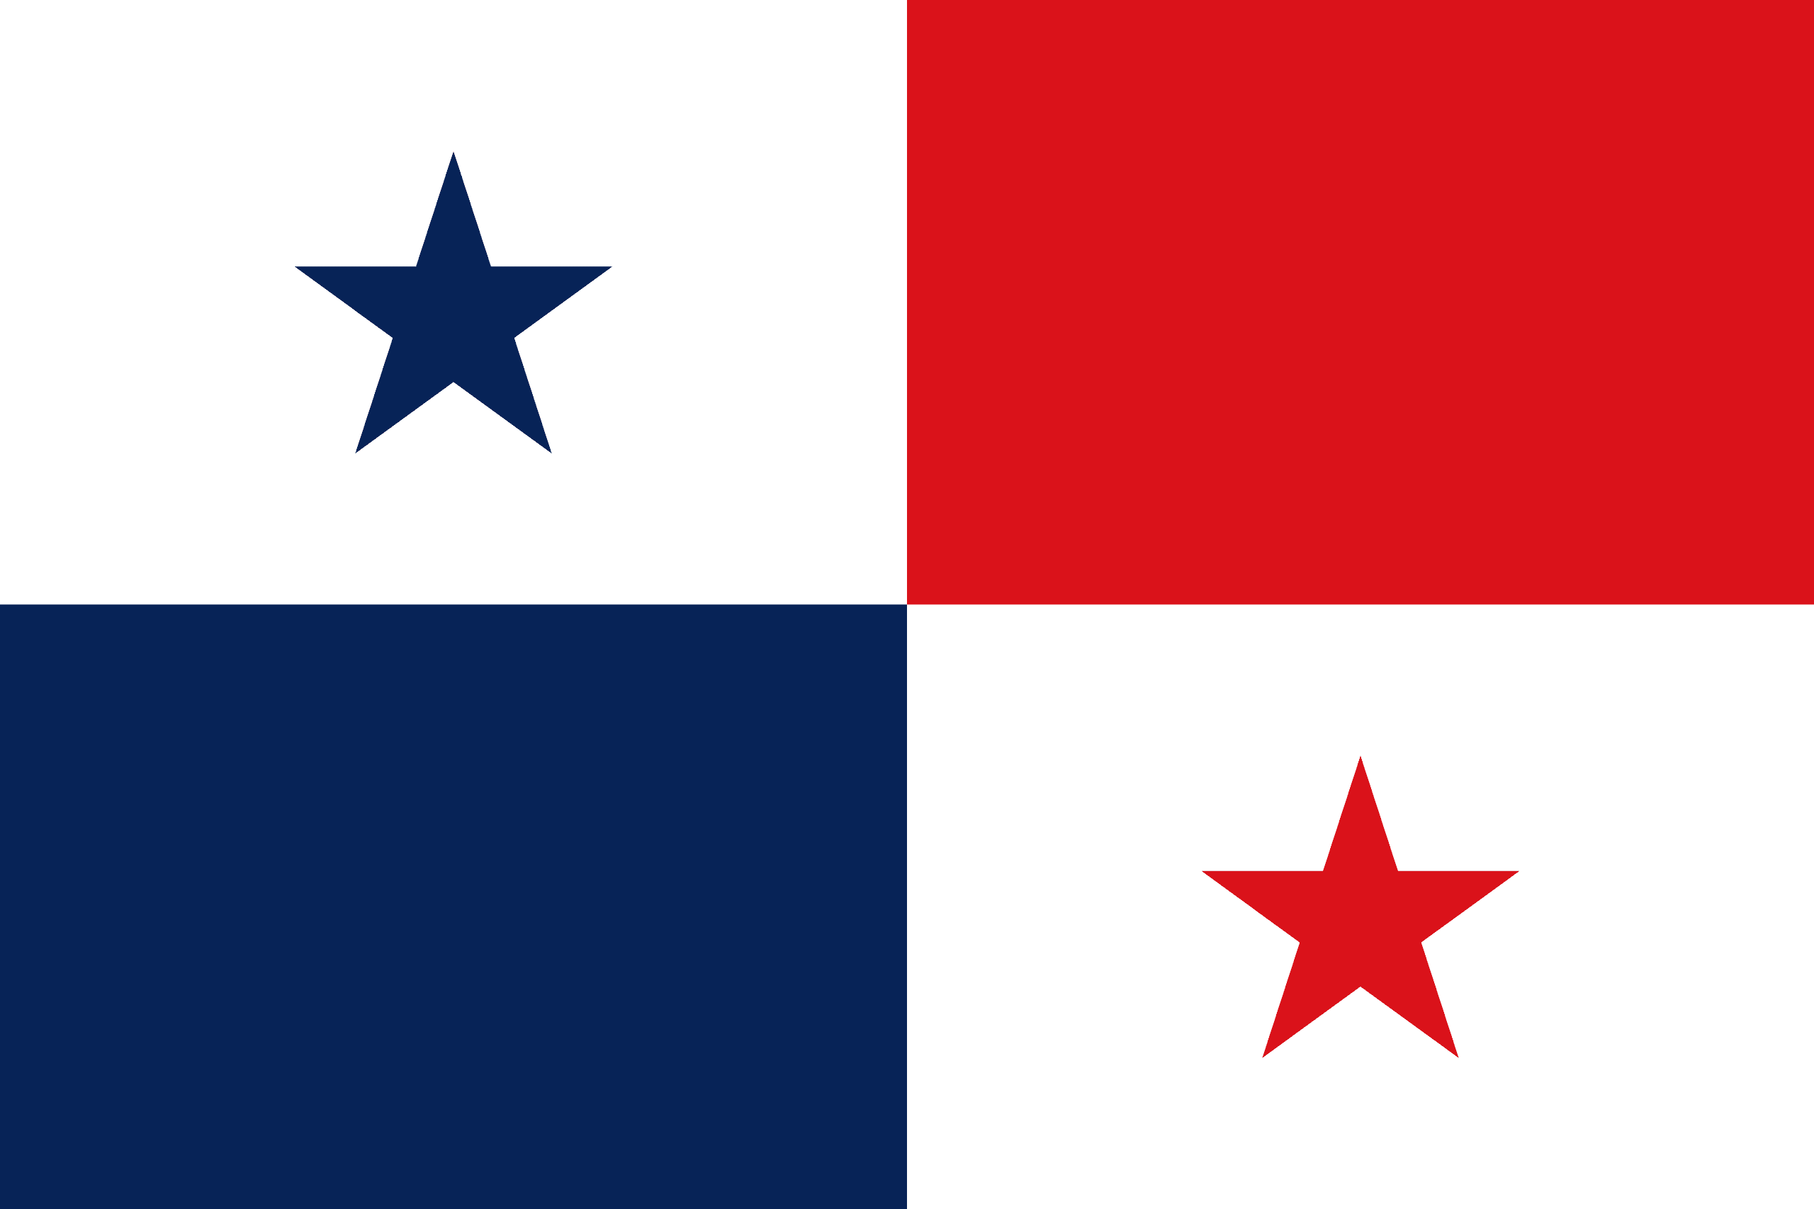
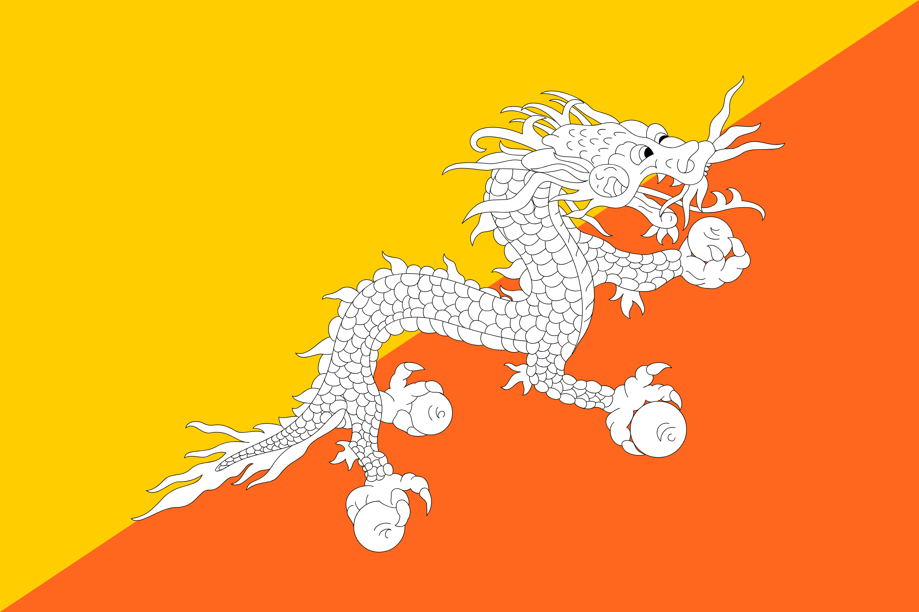


















Country Flags
Appendix B

Slide 13
Services
{company_name} | Asset pack
{biz_summary}
The services includes-
Crowding of teeth
Gaps between teeth
Protruding upper teeth
Under bite or lower protrusion
Open or cross bite
Deep overbite
They perform extraction of the teeth majorly due to-
Decay or damage to the tooth
Gum disease
Extensive tooth cracks
Poor positioning or functionality
01
General and Preventative
Dental Check-ups
Gum Disease Treatment
Teeth Cleaning
03
Restorative
Root Canal Treatment
Dental Implants
Invisalign
Prosthodontics
Periodontics
05
Cosmetic
Cosmetic Dentistry
Veneers
Dental Crowns
SmileStyler Clear Aligners
02
Orthodontics and Dentures
Implant
Dental and facial irregularities
04
Wisdom teeth & extractions
Tooth Extraction
Wisdom Teeth Removal
.
They perform x-rays which includes-
Small Dental X-Ray
OPG
3-D Cone Beam X-Ray
Further, provide services for Gingivitis and Periodontitis
These treatments are performed for –
Dental decay
Dental trauma
A broken filling or crown
Extreme wear
Severe gum disease
Replace missing teeth
They provide solution to
Crooked, oddly shaped or misaligned teeth
Crowded teeth
Broken, chipped or worn teeth
Gaps between teeth
Permanently stained or discolored teeth
Source: {company_name}, Services, Link; all accessed on {date}

